Slide 1
Social Media Debate Platform
By: Alex Frias
Alexandra Diaz

Slide 2
System Description
Our project is social network for debates
Users can create/delete polls, edit profile, and follow users.
Each user will have a feed of polls organized by most recent to latest poll creation.
These polls will have tags where users can categorize what polls they would like to see on their feed.
Users can like/dislike, comment, and bookmark polls.
Users can also actively search for users and polls.

Slide 3
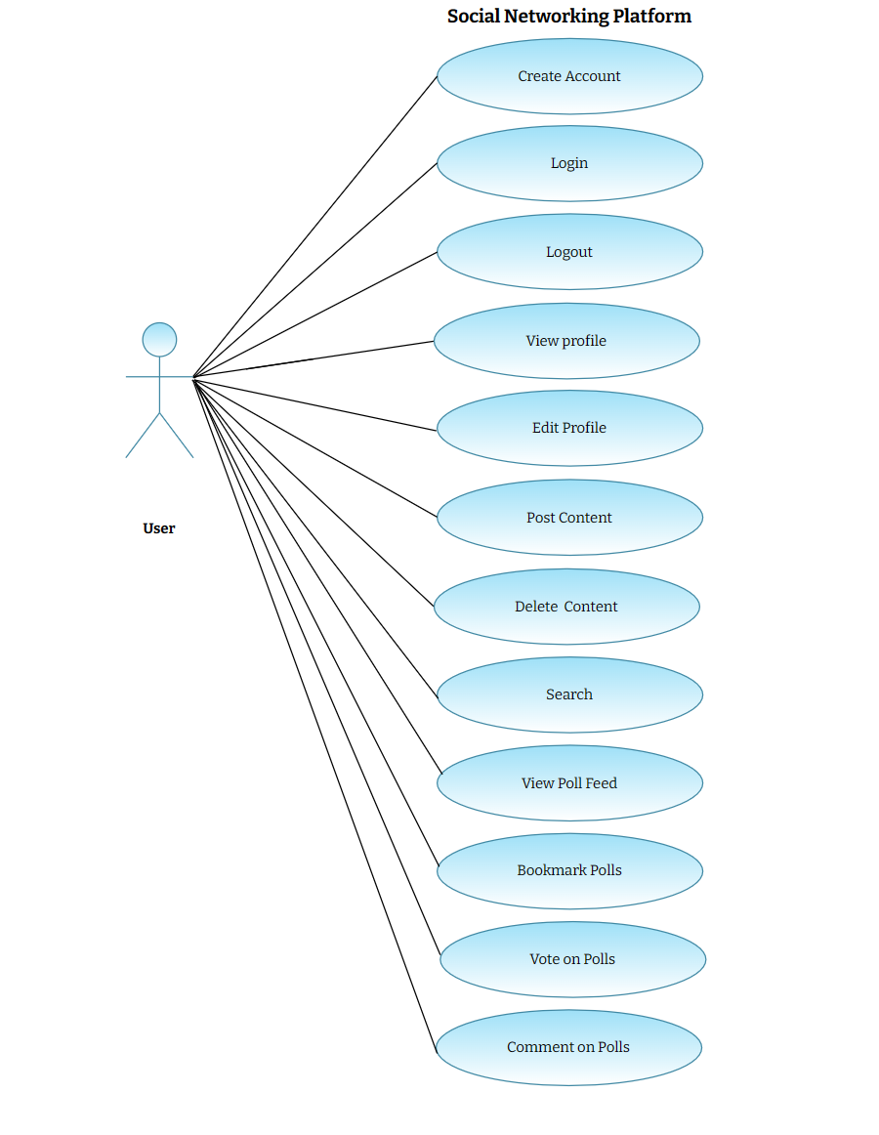
Use Case Diagram

Slide 4
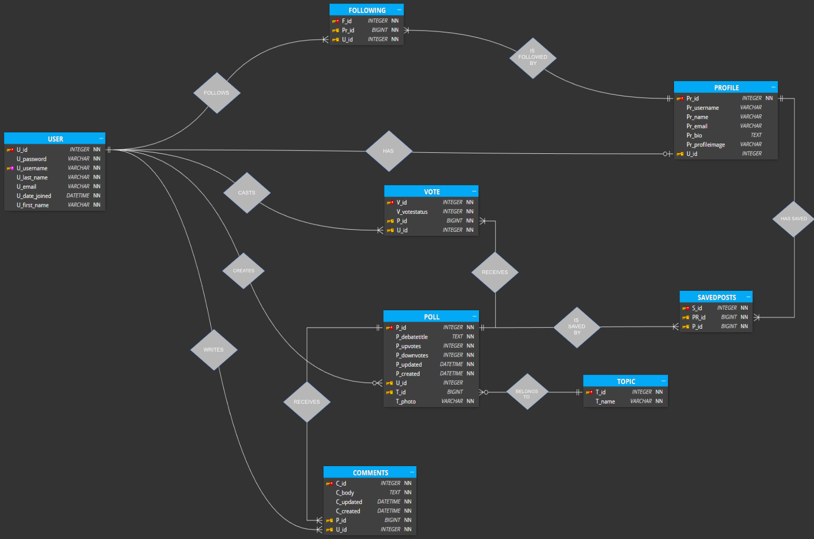
E/R Diagram and Schema

Slide 5
Implementation
Integrated Development Environment (IDE)
Visual Studio
Database
SQLite
Frontend
HTML/CSS/Javascript
Backend
DJango

